Slide 1
Cyber terrorism and Information warfare
Present by:
Amjad Ahmed (021-19-0056)
Tanveer Ul Haq (021-19-0057)

Slide 2
Agenda
Cyber crime
Cyber terrorism
Cyber Terrorism Types
Information of Warfare
Types of information warfare
Tools of information warfare

Slide 3
Cyber crime
Cybercrime is criminal activity that either targets or uses a computer, computer network or a Network device.
Mostly cybercrime is committed by cybercriminals or hackers who want to make money and any group of people and organization carry out bad reputation and damage the software , Business

Slide 4
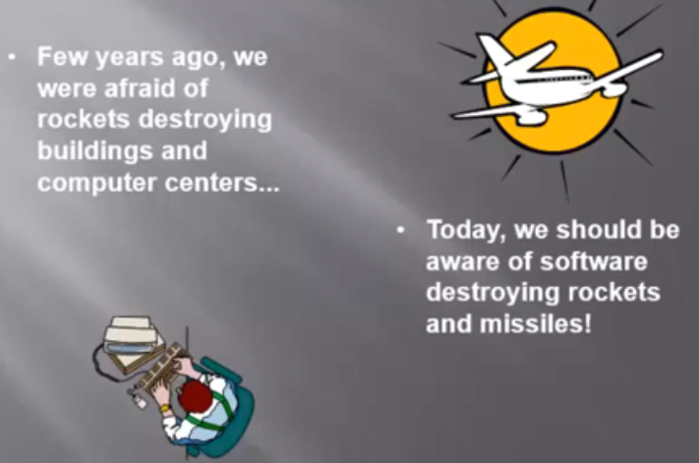

Slide 5
Cyber Terrorism
Cyberterrorism is the convergence of cyberspace and terrorism. It refers to unlawful attacks and threats of attacks against computers, networks and the information stored therein when done to intimidate or coerce a government or its people in furtherance of political or social objectives.

Slide 6
Cyber Terrorism Types
Hacking ( hack data unauthorized asses system)
Data Stealing (Data transfer personal information financial information)
Bank System break (Financial details of asses)
Gaining Publicity (Hack any websit modified )
Compromising Network (Break the network Communication, info to shear)
Virus Writing (asses system of any install virus )

Slide 7
Major Targets of cyber terrorism
Military Networks
Government System and Websites
Ecommerce and Financial Institutes
Telecommunication

Slide 8
Cyber terrorism
These are the websites in Pakistan so already attack on these websites
Lahore Hight Court (LHC)
PML-N website
Faisalabad police Department website
Pakistan army and other government website
T20 section of Pakistan televisions sport website
Tameer Bank Limited and HBL or MCB website

Slide 9
Crimes punishment laws
Crime | Punishment | Fine | section
Criminal Access | 3 year | 3 lac | Sec 3
Data Access | 3 year | 3 lac | Sec 4
Data Damage | 3 year | 3 lac | Sec 5
System Damage | 3 year | 3 lac | Sec 6
Electronic Froud | 7 year | 7 lac | Sec 8
Malicious code | 5 years | 5 lac | Sec 12
Cyber Terrorism | Life | 10 Million | Sec 17

Slide 10
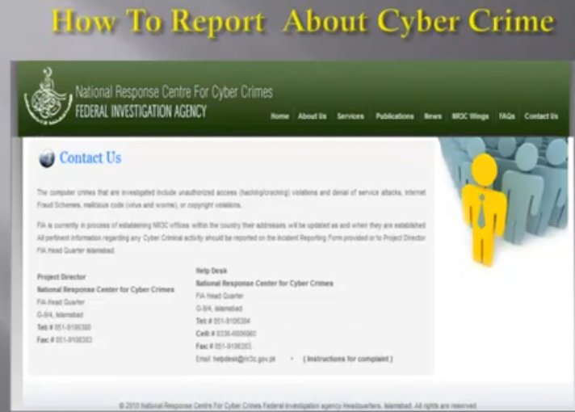

Slide 11
Preventive Measures
Use anti-virus software and firewalls-keep them up to date
Keep your operating system up to date
Don’t open emails or attachment from unknown sources
Use hard-to-guess passwords
Back-up your computer data on external drive
Avoid downloading freeware
If attacked Disconnect the network

Slide 12
Information of Warfare
Information Warfare is any action to Deny, Exploit, Corrupt or Destroy the enemy's information and its functions; protecting ourselves against those actions and exploiting our own military information functions
Information warfare refers to creation disaster by damaging the computer system and resource that used to manage critical infrastructure it is also known as cyber warfare
information warfare is the offensive and defensive use of information and information system to deny, corrupt, exploit or destroy an adversary information or information system

Slide 13
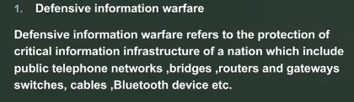
Types of information warfare two types of information warfare

Slide 14
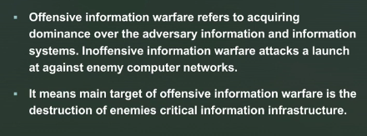
2 offensive information warfare

Slide 15
Tools of information warfare
Malware attacks
Viruses (attached with file)
Worms
Spyware and adware (Jasso)
Hacking (national Super system access modified info)
Denial of services (not use proper services disrupt many of pops and mail)

Slide 16
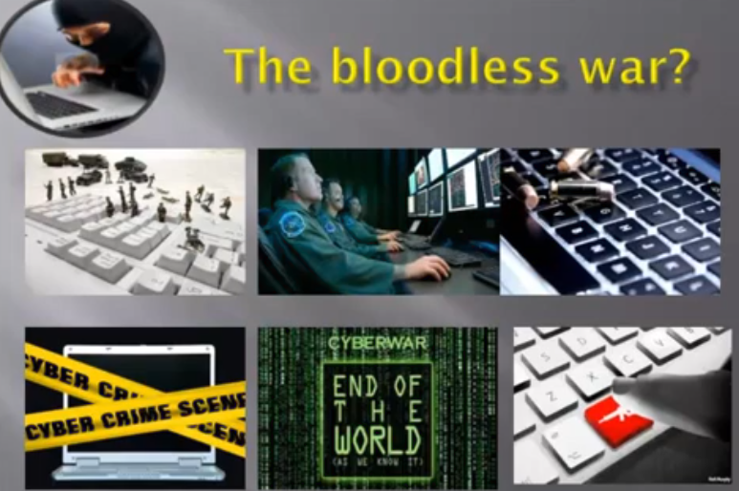

Slide 17
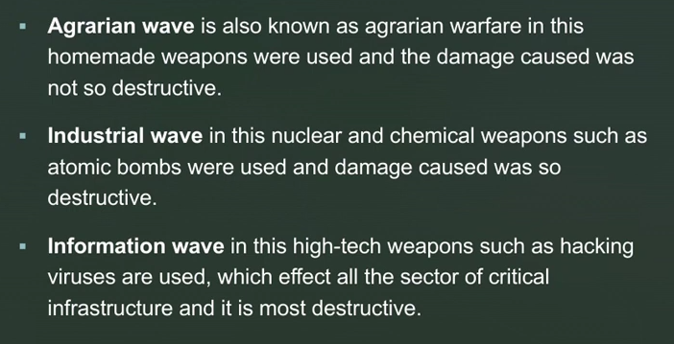
Three wave of Warfare

Slide 18
Cyber Warfare critical infrastructure
Main cyber warfare between countries attack on these which given blew there
Gas and oil storage and delivery
Water supply system
Banking and Finance
Transportation
Electrical Energy
Telecommunication

Slide 19
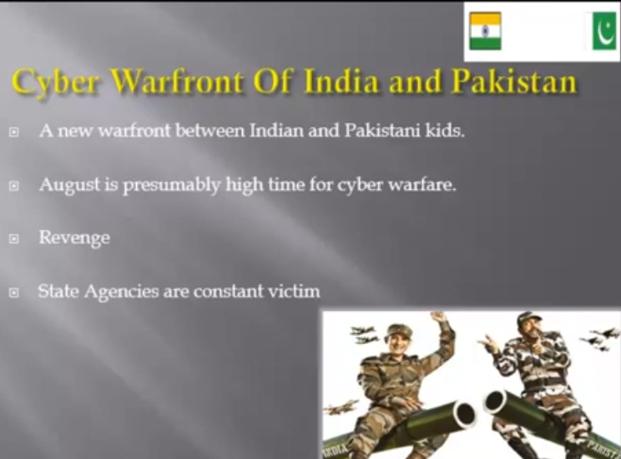

Slide 20
Thank you

